Slide 1
Income Dataset Analysis
TEAM MEMBERS
YASH BAROT
SAACHI SHAH
DEEP SHAH
PIYUSH THAPAR

Slide 2
Problem statement
This project explores logistic regression using Income data set. We will try to predict the salary class of a person based upon the given information.
We can explore the possibility in predicting income level based on the individual’s personal information.

Slide 3
Packages
Faraway:Loads Functions and Datasets.
ggplot2: A system for 'declaratively' creating graphics, based on "The Grammar of Graphics". You provide the data, tell 'ggplot2' how to map variables to aesthetics, what graphical primitives to use, and it takes care of the details.
moments: Function to calculate skewness.
pROC : Display and analyze ROC curves.

Slide 4
Data
This dataset comes from the UCI repository of machine learning databases. The task is to predict if an individual's annual income exceeds $50,000 based on census data.
It has 6 continuous, 8 nominal attributes.
7% have missing values.
Probability for the label '>50K' : 23.93% / 24.78% (without unknowns) Probability for the label '<=50K' : 76.07% / 75.22% (without unknowns)

Slide 5
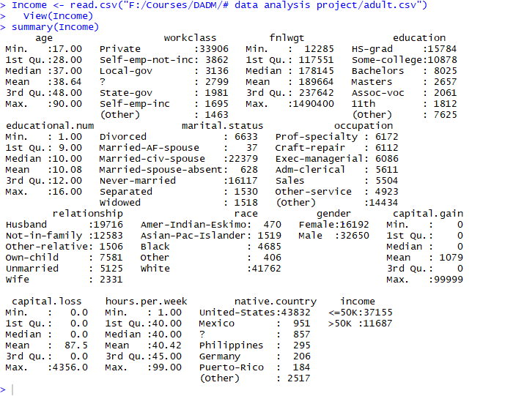

Slide 6

Data Preparation
Data Cleaning has multiple steps explained below in detail:
Step 1: Check if data types for all variables looks correct
Step 2: Categorize the variables
Notes:
Now we can revert the change the columns back to factors.

Slide 7


Step 3: Combining the different variables
a)Workclass Combining
b)Marital Status Combining
Notes:
From the structure output, we can see that some of these columns have a large number of factors. We can clean these columns by combining similar factors, thus reducing the total number of factors.

Slide 8
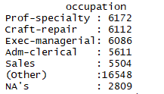
c)Native Country Combining
Step 4: Dealing with NA Values
a)Converting ‘?’ from all columns to NA.
Notes:
During the data cleaning we can see that there were some values with just a “?”. We can convert these values to NA so we can deal with it in a more efficient manner.

Slide 9
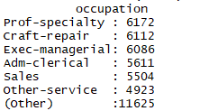
b)Remove all the NA values
Notes:
We can see that all of the NA values are found within the Occupation. We will choose to omit these values since there are only a few of them.

Slide 10
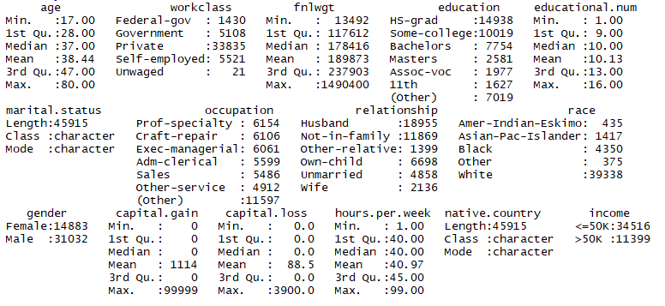

Slide 11

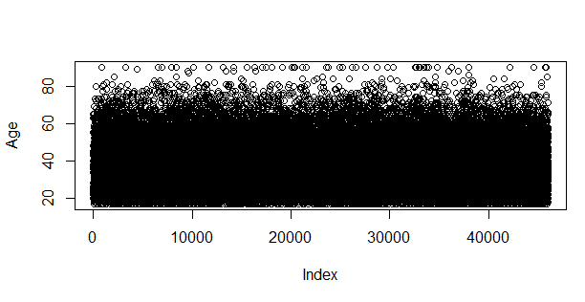
Checking for outliers

Slide 12
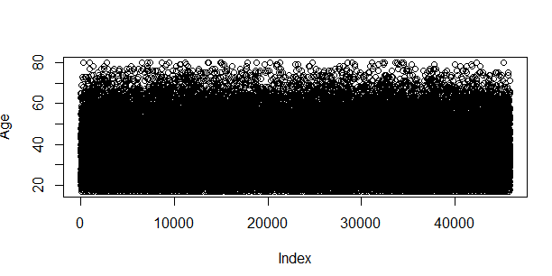
Removing Outliers
We can see many outliers for age column which are greater than 80.
We remove all the records having age >80.

Slide 13
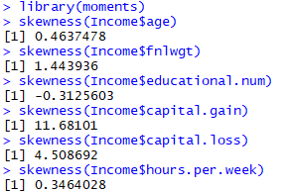
Checking the Skewness for columns
Out of the 6 variables skewness of 5 variables values implies that the distribution of the data are slightly skewed to the right or positively skewed.They are skewed to the right because the values are greater than zero.
While the skewness of 1 variable implies that the distribution of the data are slightly skewed to the left or negatively skewed because the values are lesser than zero.

Slide 14

Logistic Regression
Building the model
The purpose of this model is to classify people into two groups, below 50k or above 50k in income. We will build the model using training data, and then predict the salary class using the test group.
Splitting the model into Train and Test data.

Slide 15
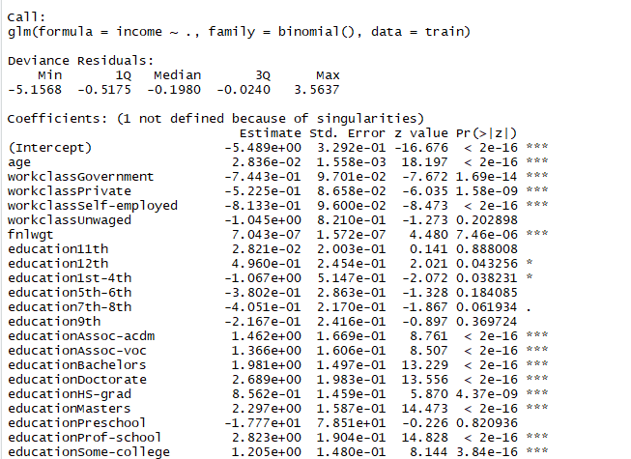
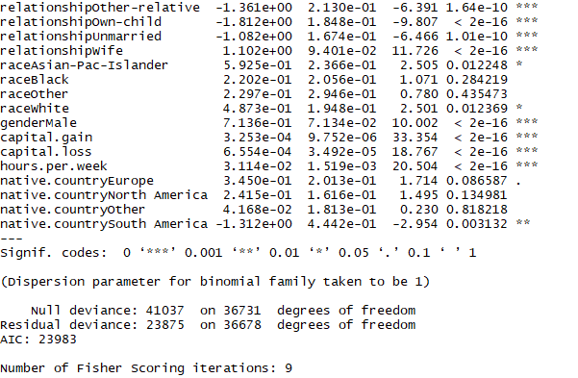
2)Training The Model

Slide 16
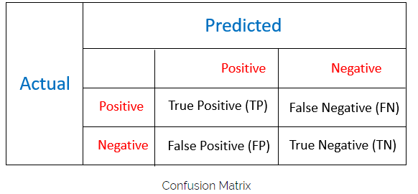
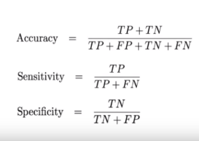
Confusion Matrix for Linear Model
Notes:
The sensitivity is defined as the proportion of positive results out of the number of samples which were actually positive.
The proportion of observed negatives that were predicted to be negatives is Specificity.

Slide 17

Logistic Regression Model Evaluation
Run the Model on the Test Data and plot confusion Metrics
Confusion matrix that we obtain is as follows:
Here we are initializing predictions on the test data using our logistic regression model, linear model.
We can compare our results using a confusion matrix. Since our predictions are predicted probabilities, we specifiy probabilities that are above or equal to 50% will be TRUE (above 50K) and anything below 50% will be FALSE (below 50K).
Notes:
Here we are initializing predictions on the test data using our logistic regression model, log.model. We specify type = “response” so that we get predicted probabilities instead of probabilities on the logit scale.

Slide 18



Value of Accuracy=84.19% Value of Specificity=92.44%
Value of Sensitivity =60%
Therefore,value of Specificity is Maximum compared to Accuracy and Sensitivity.

Slide 19

3)Building different models using various columns
Model 1:
Model2:
Model3:
Model4:

Slide 20


Comparing AUC Values of the models
MODELS | AUC VALUES
MODEL1 | 0.8168
MODEL2 | 0.8023
MODEL3 | 0.7927
MODEL4 | 0.7654

Slide 21
Data Visualization
Data visualization is the presentation of data in a pictorial or graphical format.
By using visual elements like charts, graphs, and maps, data visualization tools provide an accessible way to see and understand trends, outliers, and patterns in data.
It enables decision makers to see analytics presented visually, so they can grasp difficult concepts or identify new patterns
Specific examples of methods to visualize data:
Bar Graph
Scatter Plot
Box Plot
Strip Chart
Histogram
Density Plot

Slide 22
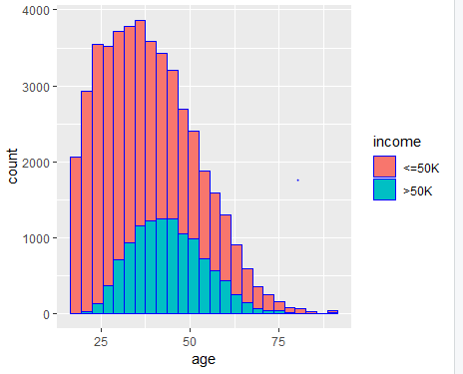
Possible Visualizations 1)Histogram
To determine percentage of people who make above 50K.
library(ggplot2)
ggplot(Income, aes(age)) + geom_histogram(aes(fill = income), color = "blue",binwidth = 3)
Notes:
From this plot we can see that the percentage of people who make above 50K peaks out at roughly 35% between ages 30 and 50.

Slide 23
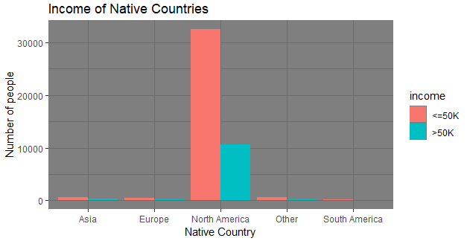
2)Bar Graph
To determine Income of Native Countries.
library(ggplot2)
ggplot(data = Income) +
aes(x = native.country, fill = income) +
geom_bar(position = "dodge") +
labs(title = "Income of Native Countries",
x = "Native Country",
y = "Number of people") +
theme_dark()
Notes:
From this graph it is evident that North America has the highest number of people having salary >50K (Almost 11K people) while Asia,Europe,North America and other countries have less than 2k people with >50k salary.

Slide 24
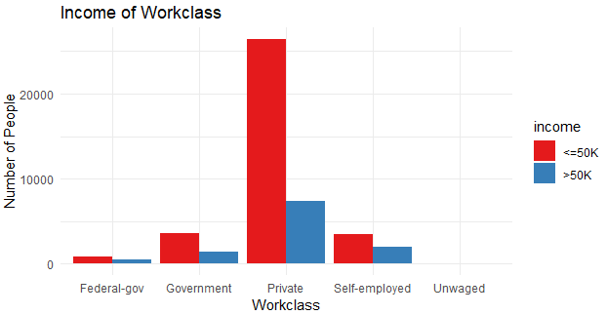
3)Bar Graph
To determine Income of Workclass.
library(ggplot2)
ggplot(data = Income) +
aes(x = workclass, fill = income) +
geom_bar(position = "dodge") +
scale_fill_brewer(palette = "Set1") +
labs(title = "Income of Workclass",
x = "Workclass",
y = "Number of People") +
theme_minimal()
Notes:
From the bar graph we can determine that more than 20k people have income <=50k in the private sector.While Government,Federal-Gov. and self employed have less than 5k people having salary <=50k.There are no unwaged workers in dataset.

Slide 25
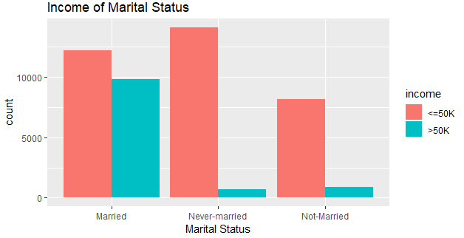
4)Bar Graph
To determine Income of Marital Status
library(ggplot2)
ggplot(data = Income) +
aes(x = marital.status, fill = income) +
geom_bar(position = "dodge") +
labs(title = "Income of Marital Status ",
x = "Marital Status") +
theme_grey()
Notes:
From this bar graph we can see that aFrom this bar graph we can see that about 10K married people have income >50K,while only 2K people who have never married have income >50K.bout 10K married people have income >50K,while only 2K people who have never married have income >50K.

Slide 26
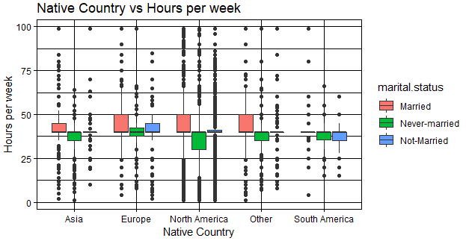
5) Box Plot
To determine hours per week people
work in the Native country.
library(ggplot2)
ggplot(data = Income) +
aes(x = native.country, y = hours.per.week, fill = marital.status) +
geom_boxplot() +
labs(title = "Native Country vs Hours per week",
x = "Native Country",
y = "Hours per week") +
theme_linedraw()

Slide 27
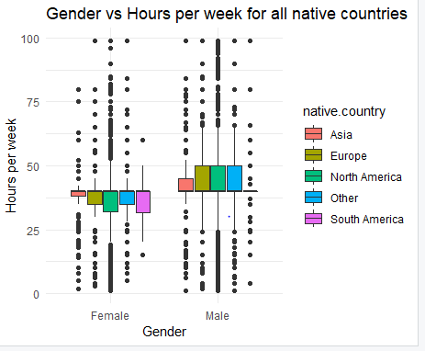
6) Box Plot
To determine hours per week people work
in the Native country based on gender.
library(ggplot2)
ggplot(data = Income) +
aes(x = gender, y = hours.per.week, fill = native.country) +
geom_boxplot() +
labs(title = "Gender vs Hours per week for all native countries",
x = "Gender",
y = "Hours per week") +
theme_minimal()

Slide 28
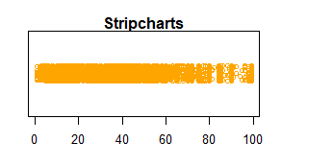
8)Stripchart of Hours per week.
r=stripchart(Income$hours.per.week,
method = "jitter",
col = "orange",
pch=1,
main="Stripcharts",
xlab="Number of hours per week")

Slide 29
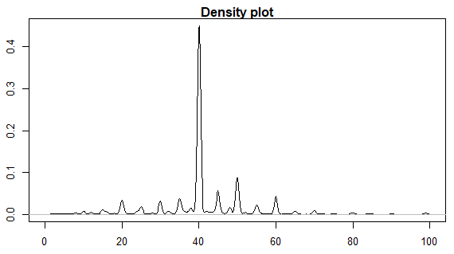
9)Density Plot of Hours Per Week
library(ggplot2)
plot(density(Income$hours.per.week),
main = "Density plot")
curve(dnorm(x, mean=m, sd=std),
col="darkblue",
lwd=0.25, add=TRUE)

Slide 30

Correlation Coefficient
The correlation coefficient of two variables in a data set equals to their covariance divided by the product of their individual standard deviations. It is a normalized measurement of how the two are linearly related.
If the correlation coefficient is close to 1, it would indicate that the variables are positively linearly related. If the correlation coefficient is close to -1, it would indicate that the variables are negatively linearly related.
From this,we can say that the correlation is strong and positive.

Slide 31
Conclusion
This project explores logistic regression using Income data set and we predicted the salary class of a person based upon the marital status, workclass, native country,gender and age using different graphs and conclude that people in North America between age group 30-50 have income greater than 50k among which are people who are married and females.
Confusion matrix is a measurement of overall prediction accuracy. Since the majority of observations in the data set has income less than $50,000 a year, sensitivity and specificity contribute to the overall accuracy by different weights.

